Slide 1


CNOS(Project) – Installation of an Intranet network at the Data Center in Iasi
Presented by Ekram Mohammad Shaidul and Professors: Luminița Scripcariu and
Nnoli Mbanefo Nnaemeka Petre D. Mătăsaru
Group: 5311
20/05/2020

Slide 2

Company Profile – Who are we?
E&N internet solutions SRL

Slide 3
Client Profile
The Amazon Data Center based in Strada Sfântul Lazăr nr. 27, Iași, Romania pioneered cloud computing in 2006, creating cloud infrastructure that allows you to securely build and innovate faster.
They are continuously innovating the design and systems of their data centers to protect them from man-made and natural risks.
Moreover, they also implement controls, build automated systems, and undergo third-party audits to confirm security and compliance. As a result, the most highly-regulated organizations in Iasi trust this center every day.

Slide 4

A brief analysis of the undertaking project
Type of network
Network class
Network structure
Future plans

Slide 5
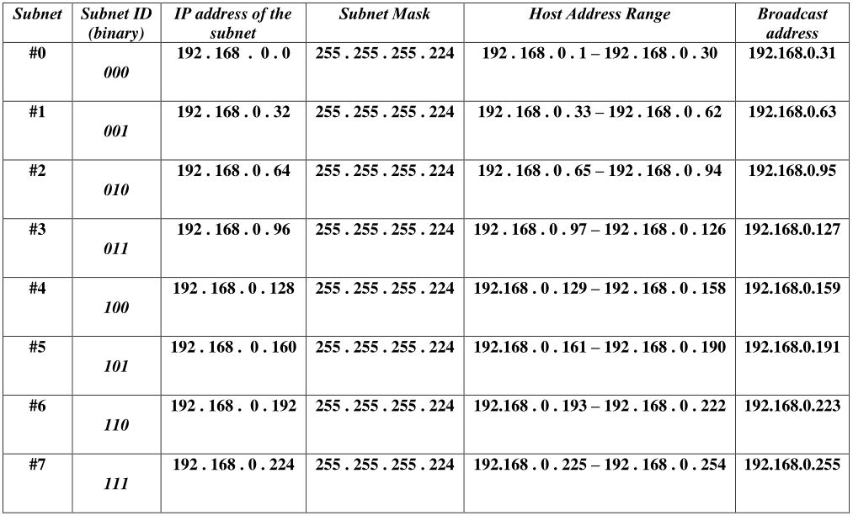
An in-depth reviewing of the network

Slide 6
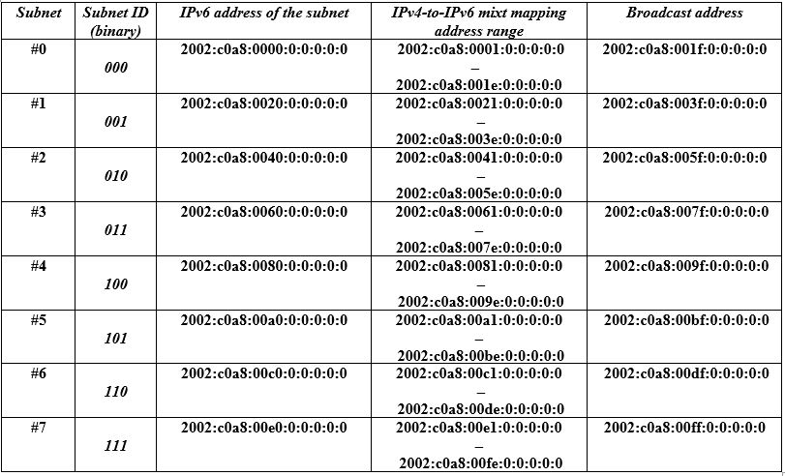
IPv4-to-IPv6 mixt mapping addresses

Slide 7
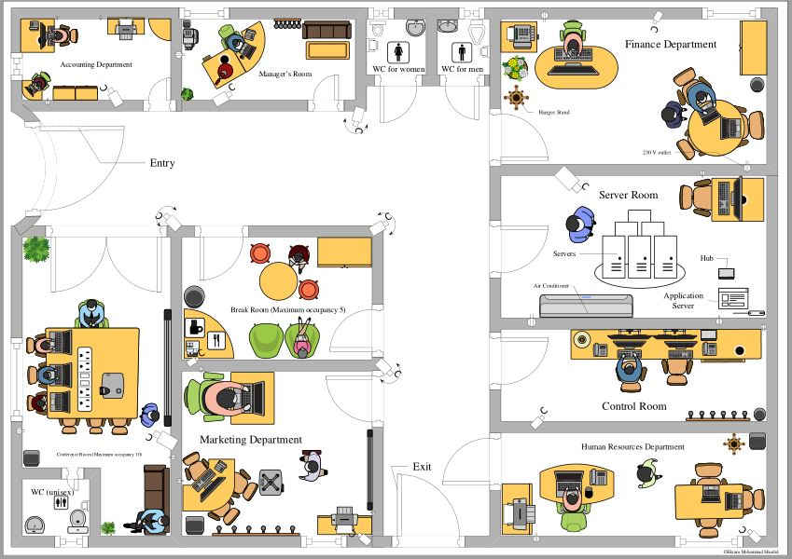
Layout of the first floor modeled on MS Visio 2019

Slide 8
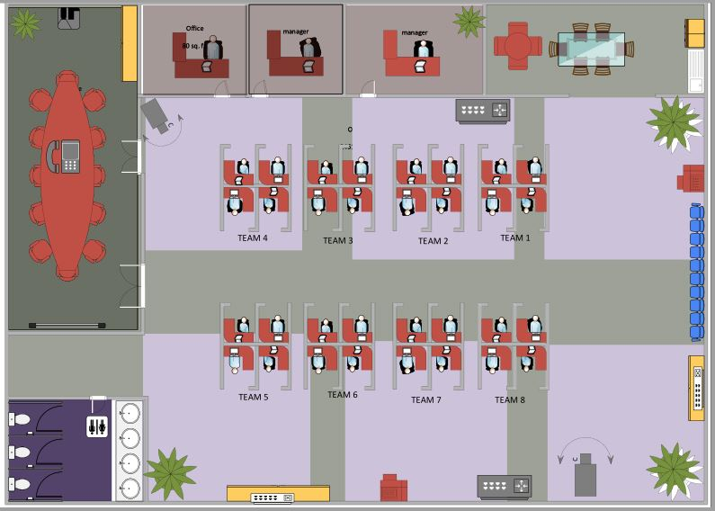
Layout of the second floor

Slide 9
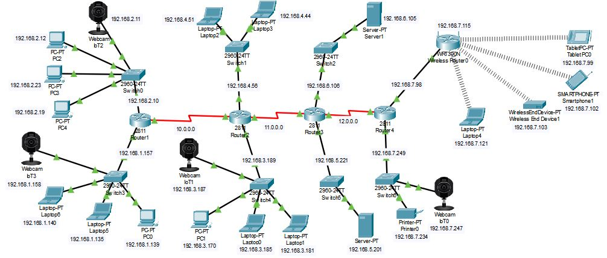
The Network infrastructure map – designed with Cisco Packet Tracer 7.3.0

Slide 10
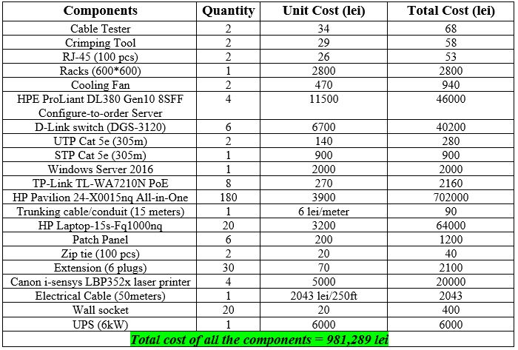
Bill of Materials

Slide 11
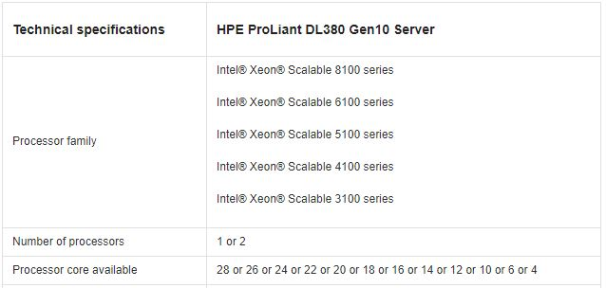
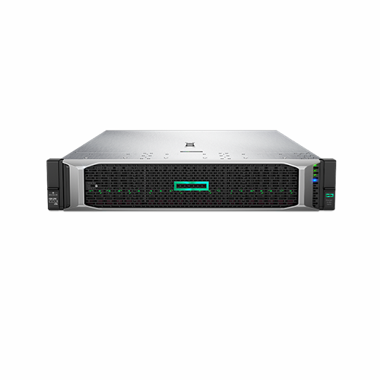
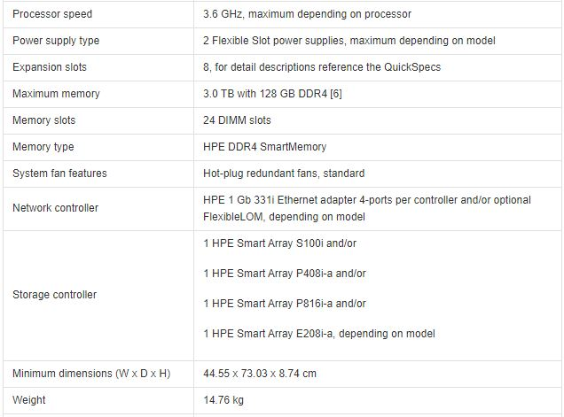
Device Specs - Hewlett Packard 868703-B21 HPE PROLIANT DL380 GEN10 8SFF Server

Slide 12
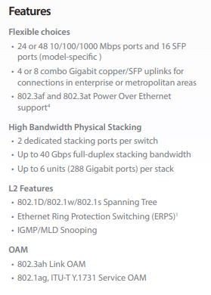
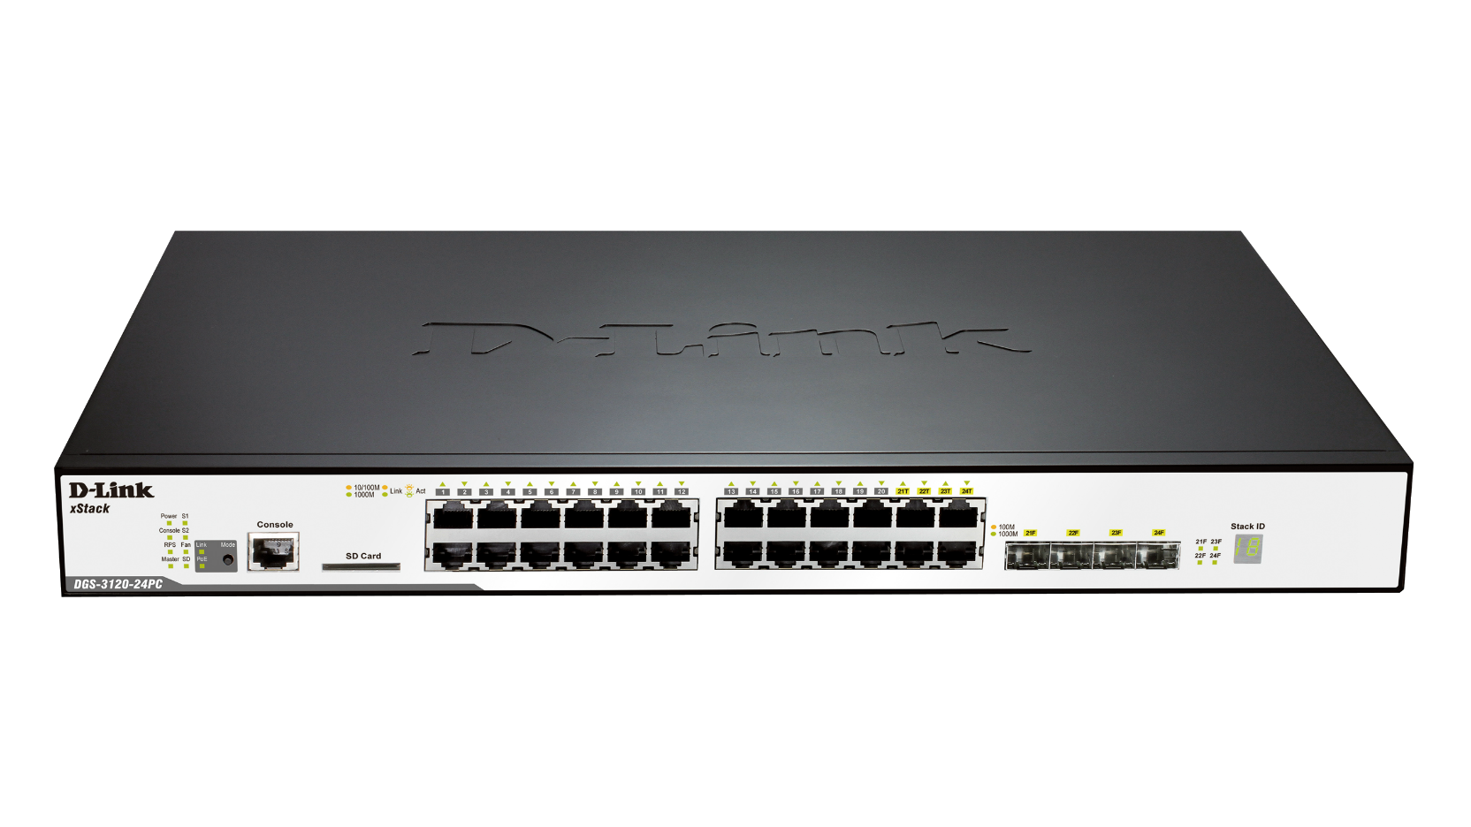
Device Specs – D-Link (DGS-3120) switch

Slide 13
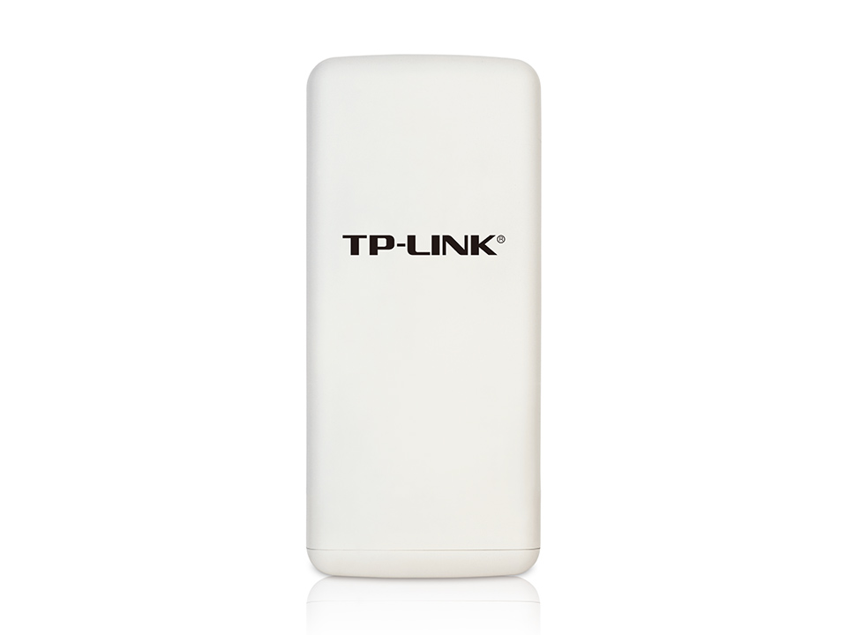
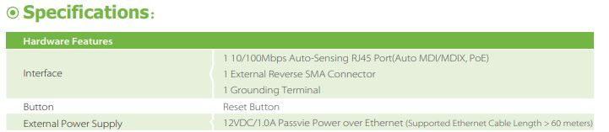
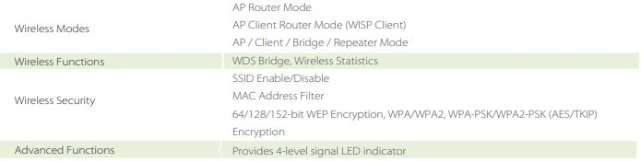
Device Specs -TP-Link TL-WA7210N 2.4GHz 150Mbps Outdoor Wireless Access Point (PoE)

Slide 14

Workforce
Time frame for project completion: 2 weeks
Employees deployed: 8 Technicians, 4 Electricians and 1 Networking engineer

Slide 15
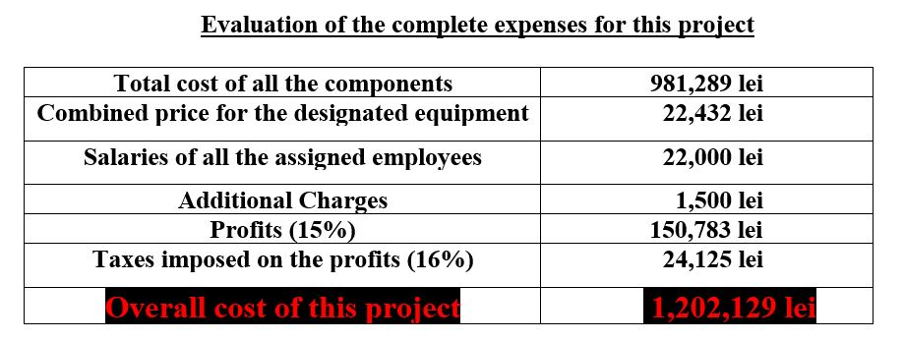

Slide 16
References
https://www.google.com/url?sa=i&url=http%3A%2F%2Fwww.vmastoryboard.com%2Fcase-stories%2F2648%2Fturner_duckworth_amazon_smile_logo%2F&psig=AOvVaw3rLVpmwIp82sFTQbI7eCnJ&ust=1589316902800000&source=images&cd=vfe&ved=0CAIQjRxqFwoTCJDHr9DcrOkCFQAAAAAdAAAAABAR
https://buy.hpe.com/us/en/servers/rack-servers/proliant-dl300-servers/proliant-dl380-server/hpe-proliant-dl380-gen10-server/p/1010026818
https://www.it-market.com/en/d-link/d-link-dgs-3120-24tc1?gclid=CjwKCAjwkun1BRAIEiwA2mJRWXiCBfsMYpe9wr9cx_PSAiEDlbPWe8Lt-tXIUK9OLYDQiTZhtDTGwxoC614QAvD_BwE
https://www.tp-link.com/ro/business-networking/outdoor-radio/tl-wa7210n/
https://www8.hp.com/ro/ro/desktops/product-details/32235715
https://www.lizengo.ro/microsoft/windows-server-2016-1-user-cal?gclid=CjwKCAjwkun1BRAIEiwA2mJRWbpbyi4wzx7h85KE0u9aocNVkDtFRIvt5Q-dKrRFFdfbpi2YYkCfABoCqPQQAvD_BwE
https://www.emag.ro/laptop-hp-15s-fq1003nq-cu-procesor-intelr-coretm-i5-1035g1-pana-la-3-60-ghz-ice-lake-15-6-full-hd-8gb-256gb-ssd-intel-uhd-graphics-free-dos-silver-8pt32ea/pd/DJPJ0WBBM/?cmpid=86846&gclid=CjwKCAjwkun1BRAIEiwA2mJRWbFHLsgdy2Yxzw5GQku8x9L1yHt6ub4Q-ok0QvrFx6z9WQfcz-wojBoC728QAvD_BwE
https://ro.rsdelivers.com/product/rs-pro/cat6utpframeb/rs-pro-cat6-24-port-rj45-rj-patch-panel-utp-1u/0556651
https://www.cel.ro/imprimante-laser/imprimanta-laser-monocrom-canon-i-sensys-lbp212dw-wireless-a4-pNyozMTAn-l/?gclid=CjwKCAjwkun1BRAIEiwA2mJRWTBioq-RuZehRR8anv-LZxOPVUjXPWuT0dqX2Ht4Am_fO12_4PLGUxoCZGAQAvD_BwE
https://www.senetic.ro/product/SRT6KXLI?gclid=CjwKCAjwkun1BRAIEiwA2mJRWUn_iWO_lHiw9qAUutw0eGppiPybvNKGkxXltaHYVJlgJCqCc-nU4xoCIO0QAvD_BwE

Slide 17

Thank You!
We would welcome your questions and/or opinions.
Notes:
© Copyright PresentationGO.com – The free PowerPoint and Google Slides template library

